Slide 1
Chosen Cyphertext Attack
Course : Network Security
Speaker : Willy Cheng-Fa Huang
Lab 1 @ NCTU

Slide 2
Agenda
Introduce RSA
Chosen Cyphertext Attack
Explain the sample code

Slide 3
Agenda
Introduce RSA
Chosen Cyphertext Attack
Explain the sample code

Slide 4
RSA
Asymmetric encryption
Public key and Private key
(n, e) and (n, d)
Encrypt and decrypt

Slide 5





Public Key
Private Key
(n,e)
(n,d)
Plaintext
Cyphertext
Plaintext

Slide 6
Agenda
Introduce RSA
Chosen Cyphertext Attack
Explain the sample code

Slide 7
Chosen Cyphertext Attack
Main idea
Technology

Slide 8
Chosen Cyphertext Attack
Main idea
Technology

Slide 9
Public known
Private unknown
(n,e)
(n,d)
123
hfueiwaf
123

Slide 10
Public known
Private unknown
(n,e)
(n,d)
1234
hfueiwafqwe
1234

Slide 11
Chosen Cyphertext Attack
Main idea
Technology

Slide 12


X
Y
Server
Relative prime to n
$$Y=C∗X^{ⅇ} mod n$$
Z
P
Receive from server
(decrypt Y)
$$P=Z∗X^{−1} mod n$$

Slide 13
Tips
Get (n, e) first.
C : flag.enc → base 64 decode → byte string to int
(for math calculate)
byte string need to be treated as hex int!

Slide 14
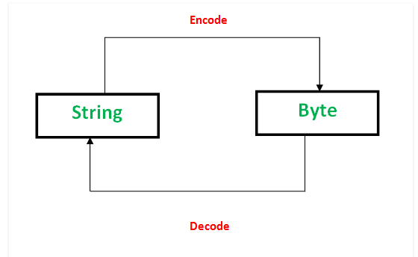
Tips
Get (n, e) first.
C : flag.enc → base 64 decode → byte string to int
(for math calculate)
byte string need to be treated as hex int!

Slide 15
Agenda
Introduce RSA
Chosen Cyphertext Attack
Explain the sample code

Slide 16
Example code
Function definition and Tools
Main function

Slide 17
Example code
Function definition and Tools
Main function

Slide 18
Function definition
def getpubkey():
with open('./pub.pem','rb') as f:
pub = f.read()
key = RSA.importKey(pub)
return key
from Crypto.PublicKey :
getpubkey().n
getpubkey().e

Slide 19
def check(cipher_text,pubkey):
with open('./flag','r') as f:
flag = f.read().strip()
flag_enc = pubkey.encrypt(int(binascii.hexlify(flag),16),'')[0]
d = SHA256.new() #hash table
dd = SHA256.new()
d.update(binascii.unhexlify(hex(flag_enc)[2:-1]))
try :
dd.update(base64.b64decode(cipher_text))
except TypeError:
print ('base64 decode error!')
sys.exit()
if d.hexdigest() == dd.hexdigest():
return 0
return 1
import base64
base64.b64decode()
base64.b64encode()
import binascii
binascii.hexlify()
binascii.unhexlify()

Slide 20
def decrypt(cipher_text):
with open('./priv.pem','rb') as f:
priv = f.read()
key = RSA.importKey(priv)
try :
text = key.decrypt(base64.b64decode(cipher_text))
except TypeError:
print ('base64 decode error!')
sys.exit()
print ('Decrypted message in base64 encoding format: ')
print (base64.b64encode(text))

Slide 21

Other tools
import gmpy
gmpy.invert(X, n)
from pwn import *
remote()
sendline()
recvline()
close()
$$P=Z∗X^{−1} mod n$$
Connect to the server without implementing socket
Get the string we need

Slide 22
Example code
Function definition and Tools
Main function

Slide 23
Main function
Give me your encrypted message in base64 encoding format :
Enter the cyphertext encoded with base64 by RSA
And then it will give you the plaintext
Answer will be : FLAG{S0_y0u_do_know_th3_cho5en_c1ph3r_4ttack!}

Slide 24
Catch tools and Capture Acknowledge!

